Slide 1
PROJECT NAME : EMPLOYEE HEALTH MANAGEMENT SYSTEM GUIDE NAME : MRS SUNANTHINI STUDENT NAME: PHILLIP C KATEMA YEAR & DEPT : 3RD YEAR, BSC REG NUMBER : 18323351062

Slide 2
ABSTRACT
Organizations currently use a manual system for management and maintenance of their employee medical information. The current system requires numerous paper forms, with data stored throughout the organizational structure. A significant part of the work of the organizations Medical Personnel involves the acquisition, management and timely retrieval of great volumes of the medical information. This information typically involves medical history, hospital records and payment records. All of this information must be managed in an efficient and cost wise manner so that organizational resources may be effectively utilized. The new EMPLOYEE HEALTH MANAGEMENT SYSTEM will automate the management of the employee medical information, making it more efficient and error free. It aims at standardizing and consolidating data, thereby ensuring integrity and reducing inconsistencies.

Slide 3
INTRODUCTION
The project titled as “Employee Health Management System” is a windows-based application. This application will provide the facility for registering organization employees with the aim of storing their health-related records. The organization medical personnel will be responsible for the management of this system. The medical personnel will be required to enter their login details to be authorized access to the system thereby ensuring safety of the data. An Access database will be maintained for storage of the data being entered into the system.

Slide 4
PROBLEM IDENTIFICATION
Employee health medical information is collected mainly on three occasions.
First, when the employee is starting their job so as for the organization to have knowledge on the health status of their employee.
Second, is each time an employee visits a hospital so that the organization can make necessary payments to the hospital.
Third, is when the employee is leaving the organization so that his/her health status at exit can be known and considered when preparing their exit package.
The challenge is to organize the management of all this process in a way that is efficient, consistent and proves useful when it is time for reporting.

Slide 5
EXISTING SYSTEM
The existing employee health management system is not standardized and efficient. Information is often written on paper forms or entered into a Microsoft Excel file. Often, information on forms is incomplete, or does not follow a uniform standard. Forms are often lost in transit between departments and multiple copies of the same information exist in the organization which leads to inconsistences in the information. This current system has the following drawbacks:
Lack of security for the data
Time consuming
Needs a lot of paper work
Leads to a duplication of data
Leads to a lot of inconsistent data

Slide 6
PROPOSED SYSTEM
The aim of the proposed system is to develop an improved system that is automated and has a central database. The proposed system should overcome all the limitations of the existing system. The system should provide proper security and reduce the manual work. The existing system has several disadvantages and many more difficulties to work well. The proposed system will try to eliminate or reduce these difficulties up to some extent. The proposed system will help the user to reduce the workload and mental conflict. It will also help the user to work in a user-friendly environment where he can easily do his job without time wasting.

Slide 7
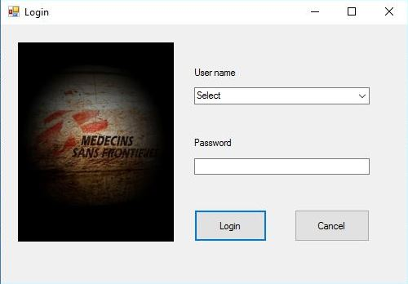
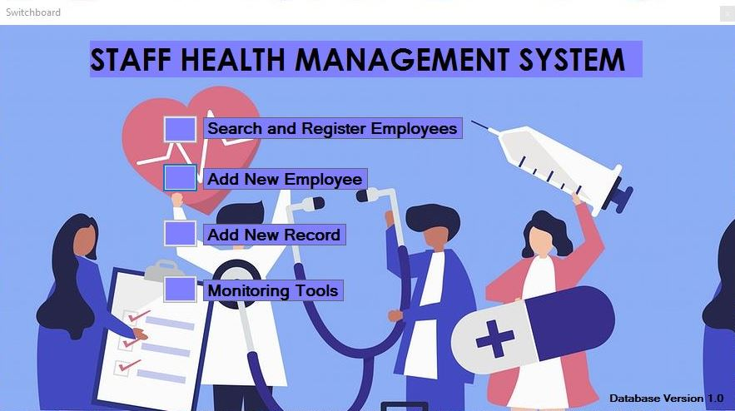
RESULTS(SCREENSHOTS)
LOGIN FORM
LANDING PAGE

Slide 8
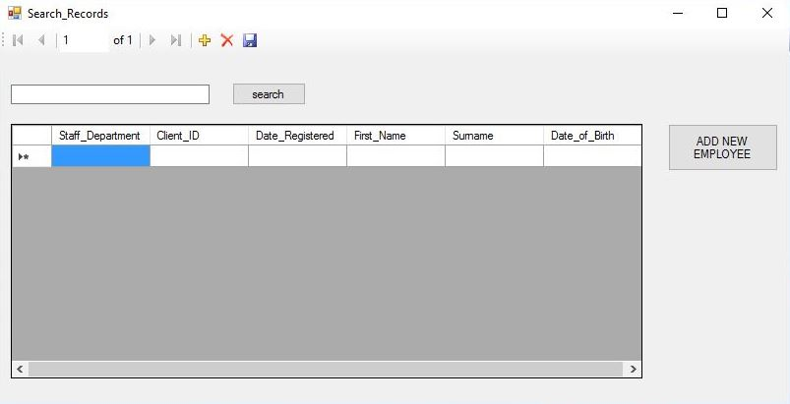
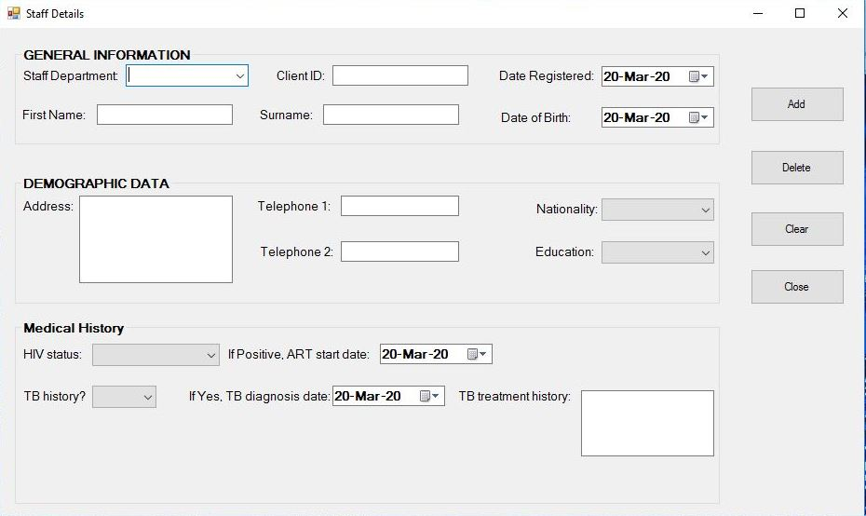
RESULTS(SCREENSHOTS) cont’d
SEARCH FORM
EMPLOYEE
REGISTRATION
FORM

Slide 9
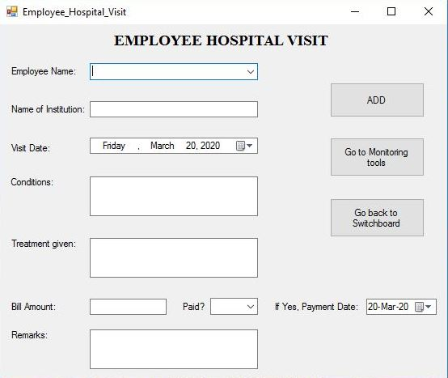
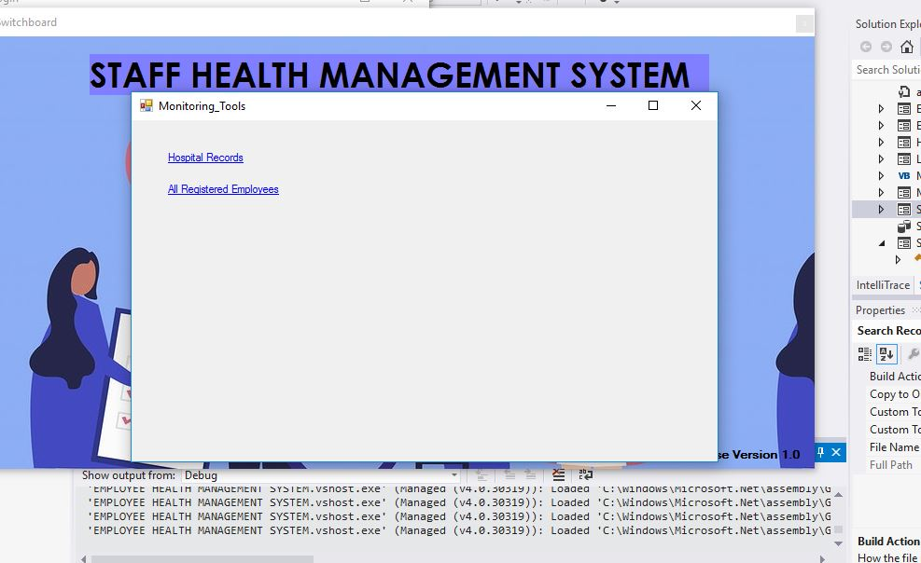
RESULTS(SCREENSHOTS) cont’d
EMPLOYEE HOSPITAL VISIT
FORM
MONITORING TOOLS
FORM

Slide 10
CONCLUSION
This system was developed with scalability in mind. Additional modules can be easily added when necessary.
All modules in the system have been tested with valid data and invalid data and everything worked successfully. Thus, the system has fulfilled all the objectives identified and is able to replace the existing system.
This software has a user-friendly screen that enables the user to use without any inconvenience. The application has been tested with live data and has provided a successful result. Hence it has proved to work efficiently.
Overall, the project has been completed successfully with the maximum satisfaction of the organization

Slide 11
END

